Slide 1



Enterprise Grade DevOps with OutSystems
João Almeida
joalmeid@microsoft.com
@jalmeida

Slide 2
What is OutSystems?
OutSystems provides the most trusted enterprise Rapid Application Development (RAD) platform to accelerate digital transformation.
OutSystems Platform is the fastest and most comprehensive way to create, deploy, change, and manage custom mobile and web applications - delivered seamlessly across all devices.
Available as a cloud or on-premises solution with deep integration to all existing systems and an open architecture
OutSystems manages the complete application lifecycle of large portfolios in thousands of enterprise organizations in 33 countries across 22 industries.

Slide 3
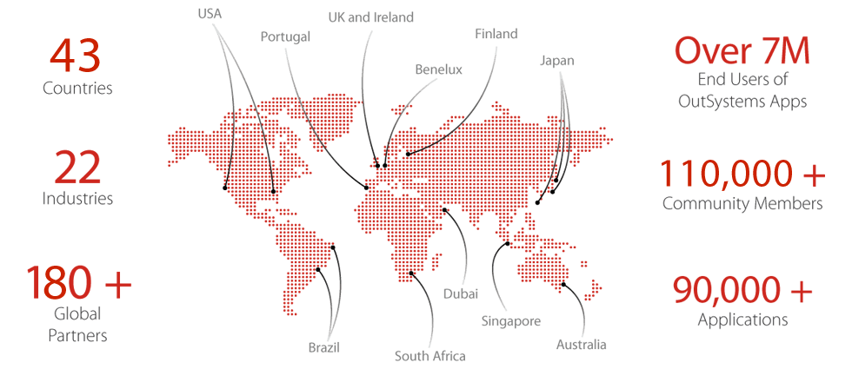
Global Presence
Countries
End Users of
OutSystems Apps
Industries
Community Members
Global
Partners
Applications

Slide 4
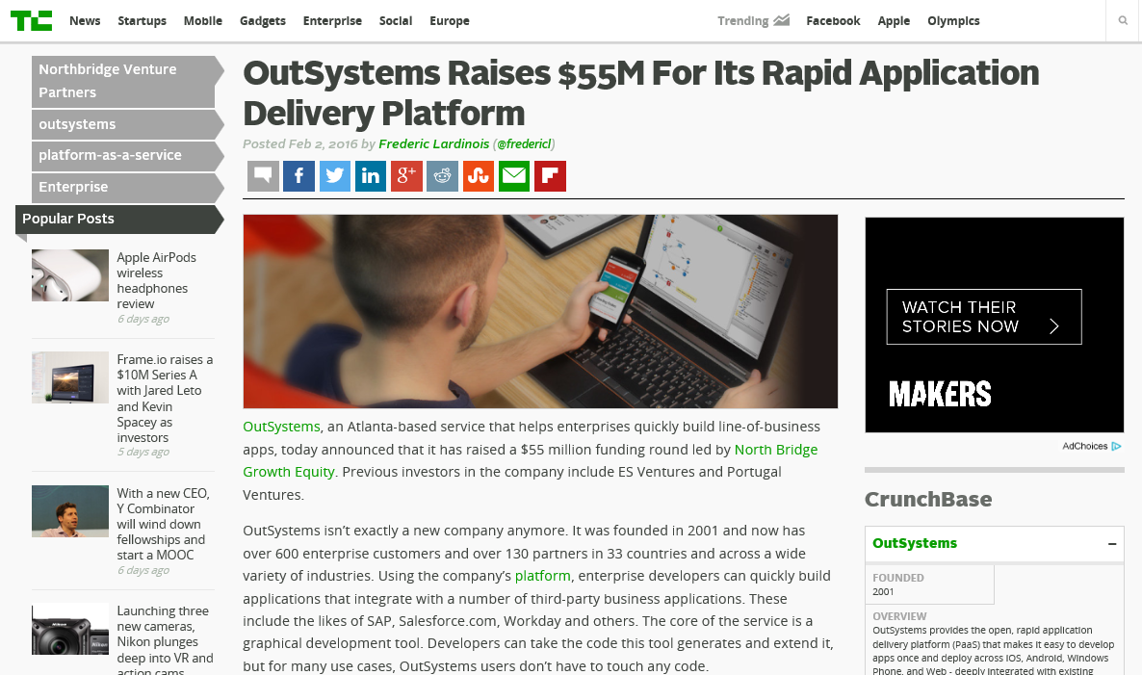
FUNDING
Total Equity Funding
$61.13M in 3 Rounds from 4 Investors
Most Recent Funding
$55M Series C on February 2, 2016
https://www.crunchbase.com/organization/outsystems

Slide 5






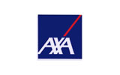


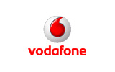
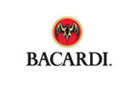
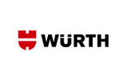
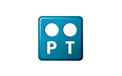

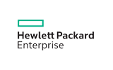




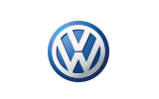



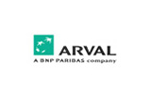









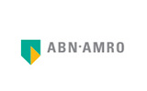
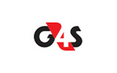


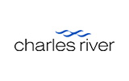








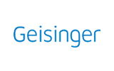



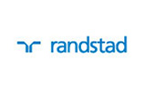
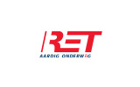



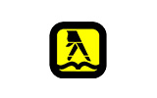
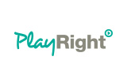

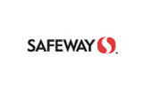





Customers Across Industries

Slide 6


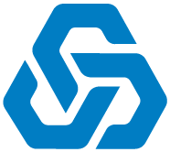


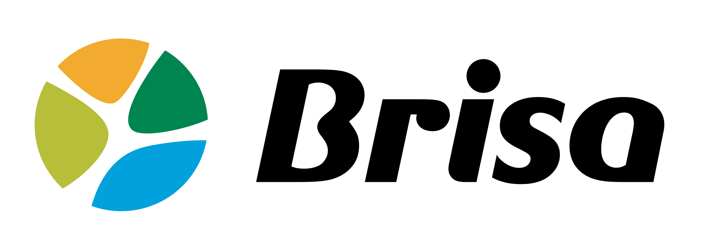
Customers in Portugal
Insurance
Finance
Telecos
Public Sector
Retail
Transportation
Healthcare
Others
Notes:
Aprox 80% coverage in EPG Territory in Portugal

Slide 7
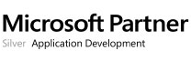
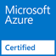

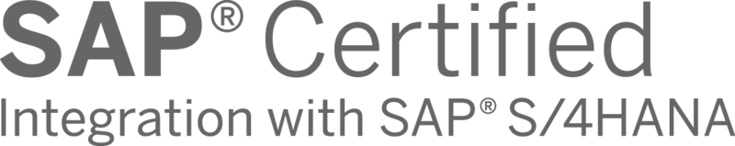
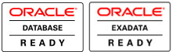

Technical Partnerships and Certifications
Available on Microsoft Azure Marketplace with a IaaS based solution, combining high-productivity application development, change management and Cloud/on-premises/hybrid development and deployment. .
With the OutSystems Connector for SAP, you can create mobile or web applications that integrate with and fully complement SAP.
This application has achieved: Oracle Exadata Ready, Oracle Database Ready, Oracle Linux Ready.
OutSystems offers a PaaS based solution allowing customers to build, deploy and manage enterprise-class web and mobile applications.

Slide 8
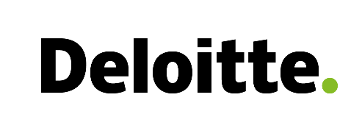

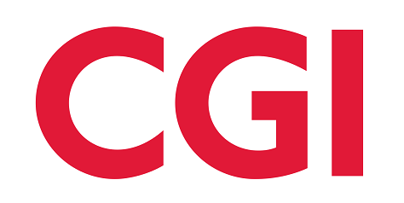
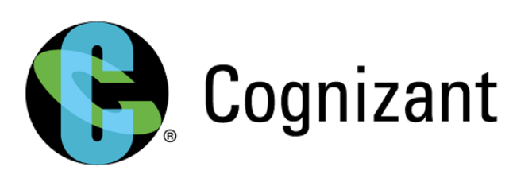
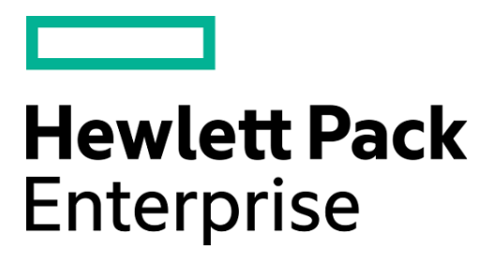

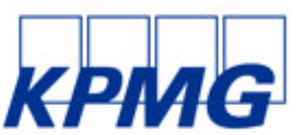
Partnerships
MORE THAN 130 GLOBAL PARTNERS
ACTIVITY
EUROPE, US, LATIN AMERICA, SOUTH AFRICA AND RECENTLY ASIA
Outsystems partner program is growing 51% YoY
Partnership with Deloitte in Jun 2016 for Center of Excellence

Slide 9
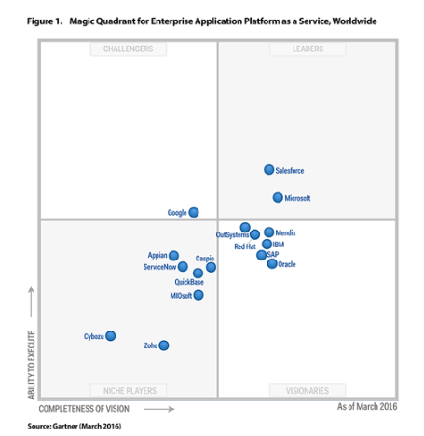
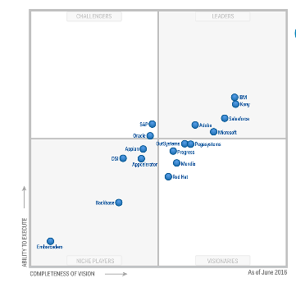
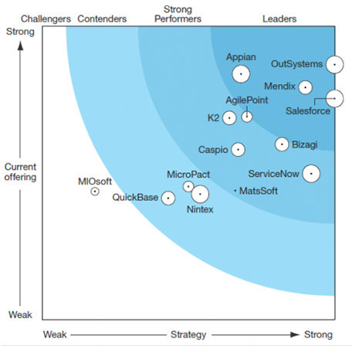
What Analysts Say About OutSystems (2016)
Visionary in the 2016 Gartner Magic Quadrant for Enterprise Application Platform as a Service
Visionary in the Jun 2016 Magic Quadrant for Mobile App Development Platforms
Leader in the Q2 2016 Forrester Wave on Low-Code Development Platforms

Slide 10
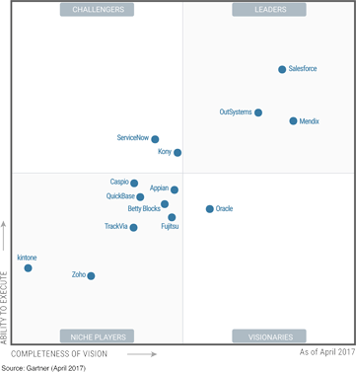
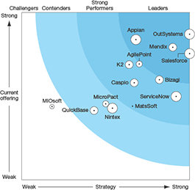
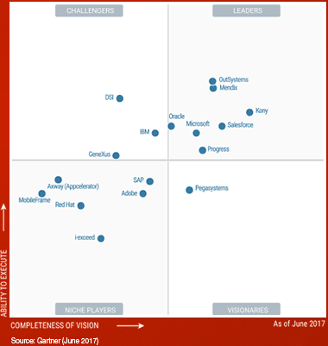
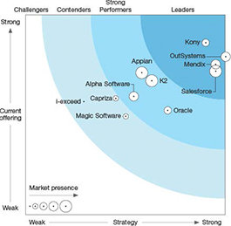
What Analysts Say About OutSystems (2017)
Leader in the 2017 Gartner Magic Quadrant for Mobile Application Development Platforms 2017
Leader in the 2017 Gartner Magic Quadrant for Enterprise High-Productivity Application Platform as a Service
Leader in the 2017 Q1 Forrester Weave on Mobile Low-Code Development Platforms
Leader in the 2017 Q1 Forrester Weave on General Purpose Low-Code

Slide 11
VALUE PROPOSITION
High Developer Productivity
Multi-channel Development
Open Platform
Enterprise-grade
Reduced costs
No-vendor lock-in

Slide 12


Slide 13
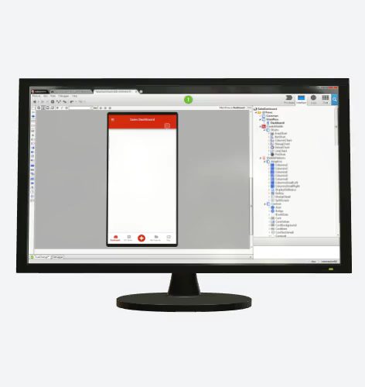
THE STRENGTHS
OutSystems Platform uses a model-driven approach to configure the app layers — UIs, data model, business processes, integration workflows, web services and APIs — enabling high-productivity development.
Developers can incorporate their own custom Java or C# code or libraries, and compose them as part of the model, as well as custom JavaScript (and CSS) for the front end.
OutSystems supports a citizen developer approach and provides a number of sample apps and industry frameworks that demonstrate how different components can quickly be brought together to build an app.
OutSystems Platform includes a number of APIs and offers API discovery with usage controlled by organization policies with centralized security governance. It also enables a granular management of user accounts and access roles.

Slide 14
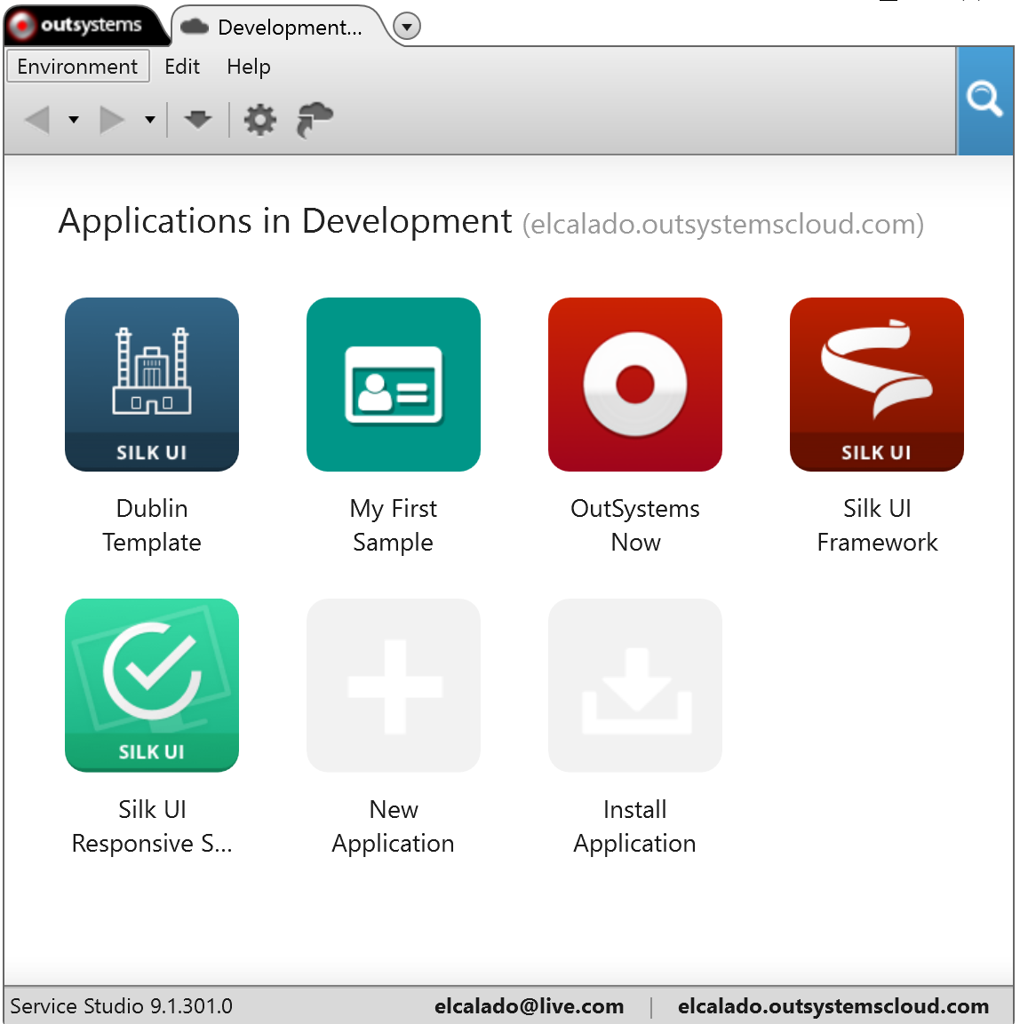
THE CAUTIONS
OutSystems Platform's metadata model to describe the behavior of an app does not give the developer complete control over the generated code, as it limits the developer's ability to define how code is generated from the metadata model.
While OutSystems' model-driven approach to development accelerates the time to a solution, developers experienced in more traditional app development approaches may struggle. They would need to understand how to balance the use of custom code and libraries against using the model.
While OutSystems allows app deployment to the OutSystems cloud, on-premises environments, or to other IaaS providers (such as Microsoft Azure or AWS), there is currently no option to directly deploy apps to Cloud Foundry-based environments.

Slide 15
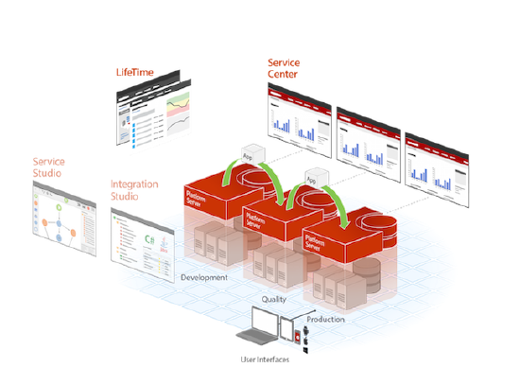
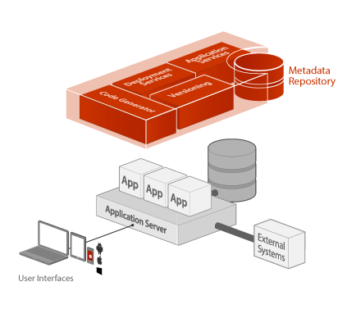
ARCHITECTURE

Slide 16
RESOURCES
OutSystems
OutSystems Website
New Platform 10 demo
Outsystems Documentation
Visual Studio Team Services
Team Services Website
Concepts
Documentation
Extensibility

Slide 18
Questions?
João Almeida
joalmeid@microsoft.com
@jalmeida

Slide 19
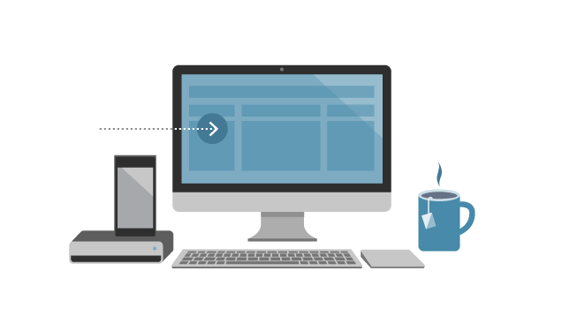
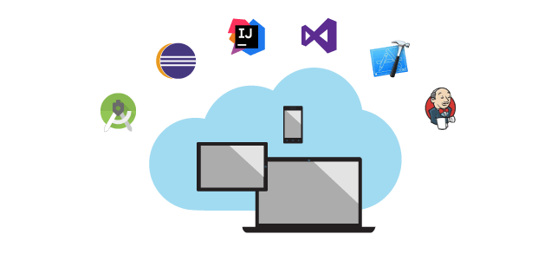
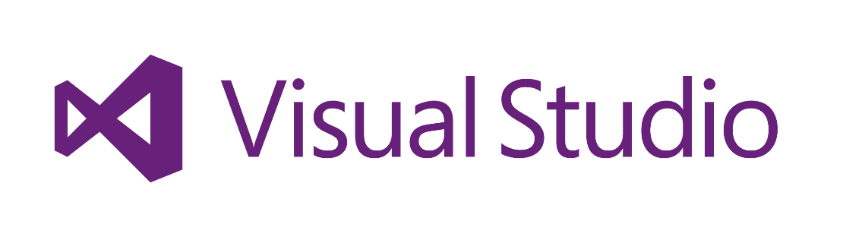

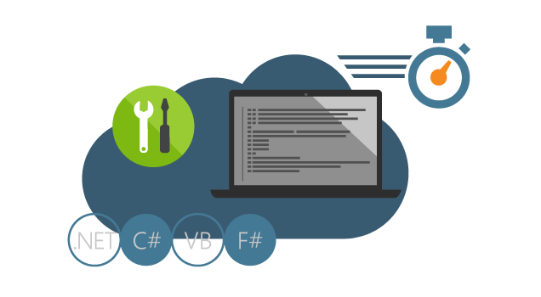
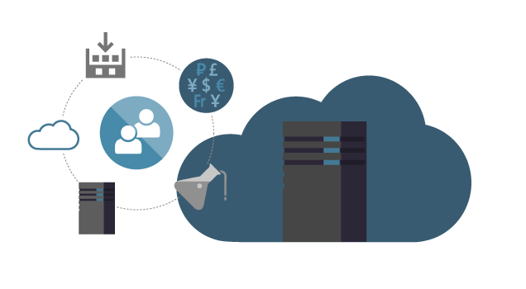
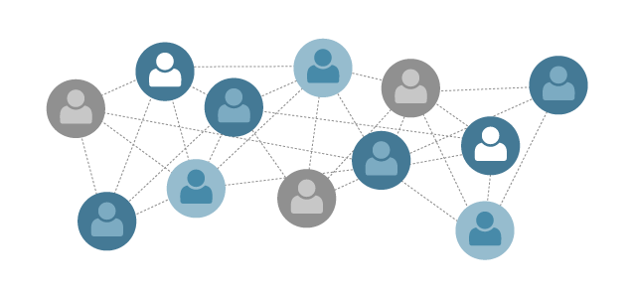
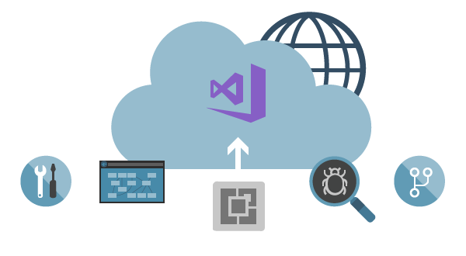
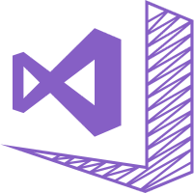
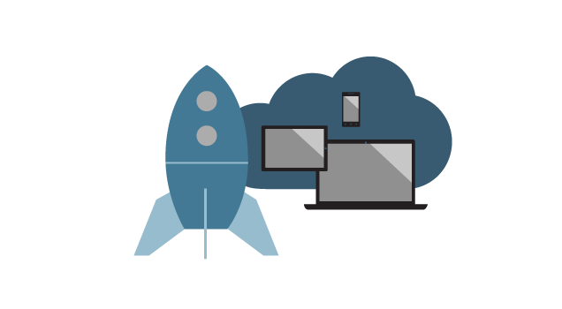


Slide 20




